Slide 1
Redfin House Clustering
Your next perfect house
Shanshan Liang 2018-11-04

Slide 2
Outline
Background
Data and Methodology
Data for the Clustering
Results
Discussion and Conclusion

Slide 3

House Hunting
House hunting process is complex and time-consuming
Hire an agent vs. DIY
Houses information source
If DIY, can we make it less painful to go through many houses manually?
 | Pros | Cons
Agent | Less effort required from the house buyers | Relies on Agent’s experiences
DIY | More and complete information is analyzed | Time consuming

Slide 4
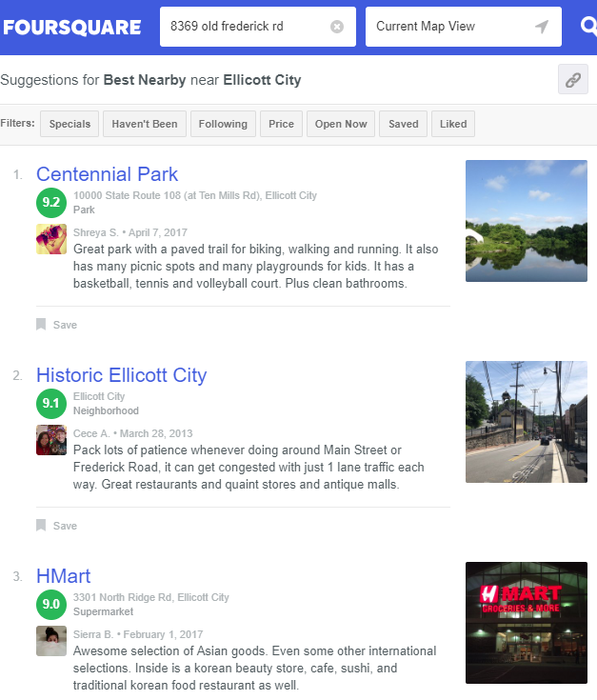
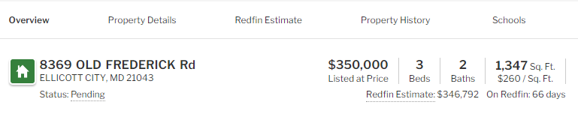
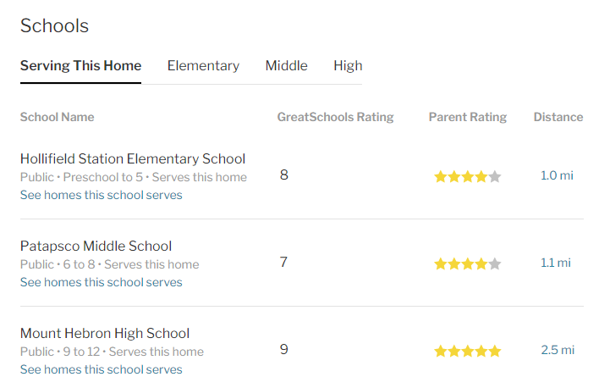
Data
Redfin Data
https://www.redfin.com/MD/Ellicott-City/8369-Old-Frederick-Rd-21043/home/10038300
Venue Data

Slide 5
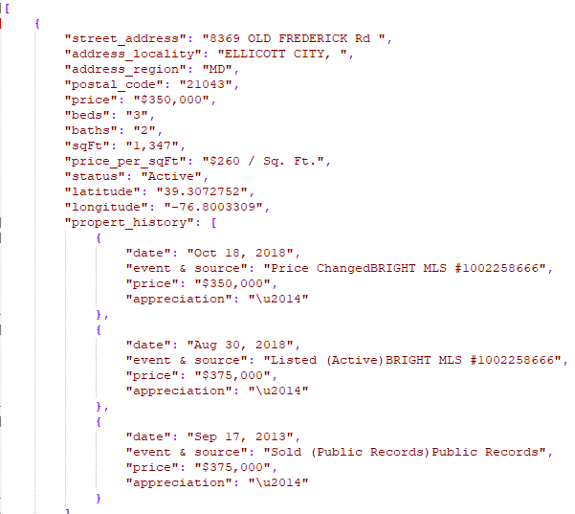
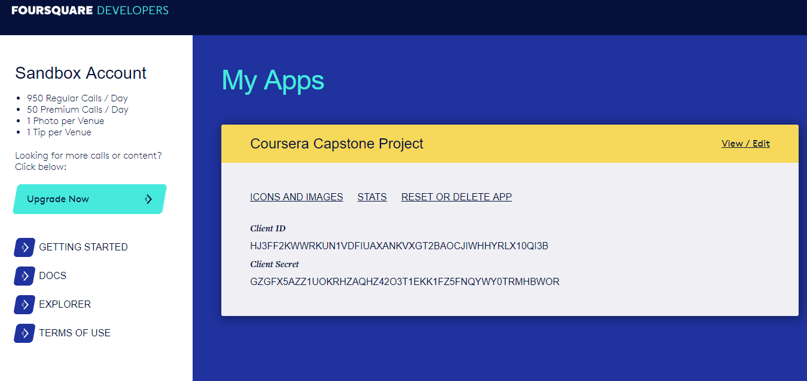
Data Cont.
Redfin Data
Python script using BeautifulSoup library to scrape webpage
Output to JSON file
Venue Data
explore function to get the most common venue categories

Slide 6

Methodology
Feature Selection
Feature Scaling
Yes for Redfin data such as house price (large number), square feet, etc
How about School Rating?? I do not standardize the school rating, prefer to put more weights on the school rating
No for Venue data due to data is already standardized by average frequency of each venue category
 | Redfin | Venue
All available features? | Long list of features | Top 100 or N venues
Selected features? | What I/stakeholder value the most | What I/stakeholder value the most

Slide 7
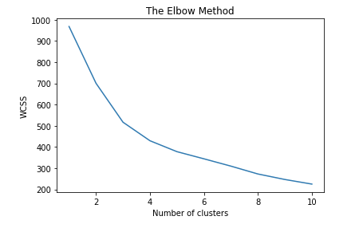
Methodology Cont.
K-Means Clustering
Unsupervised due to no prior labeling
The Elbow Method for K
3 or 4 clusters?
I looked at both and think results with 4 clusters are
easier to interpret

Slide 8
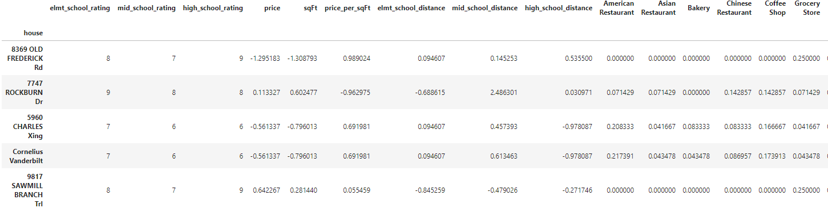
Methodology Cont.
Sample records of data for K-Means Clustering
9 features from the Redfin Data
16 distinct Venue Categories …

Slide 9
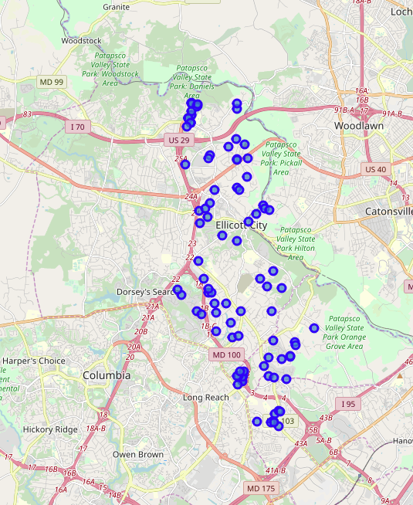
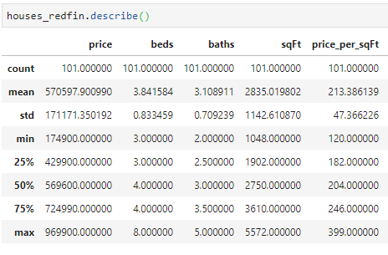
Results
Houses superimposed on Ellicott City Map
129 available houses in zip code 21043
101 houses after the filtering criteria
Selected Summary of 101 Houses

Slide 10
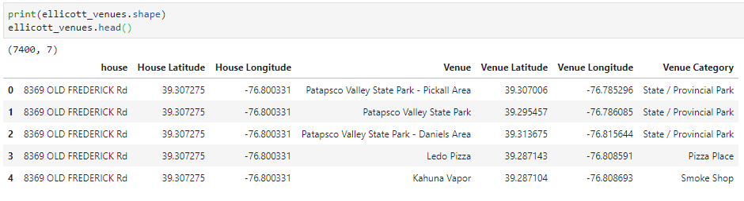
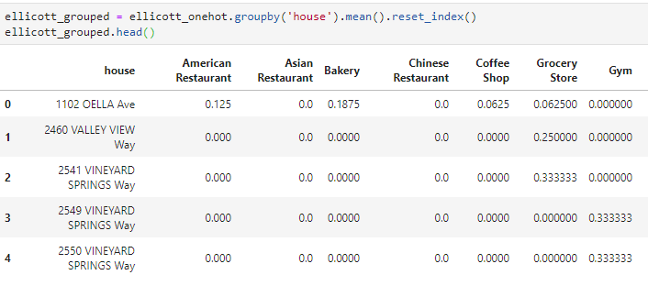
Results Cont.
For each house, collect top 100 venues, get venue name and category
7400 records for 101 houses, each house has on average 74 venues
Calculate the mean frequency of
occurrence of venue category for each house

Slide 11
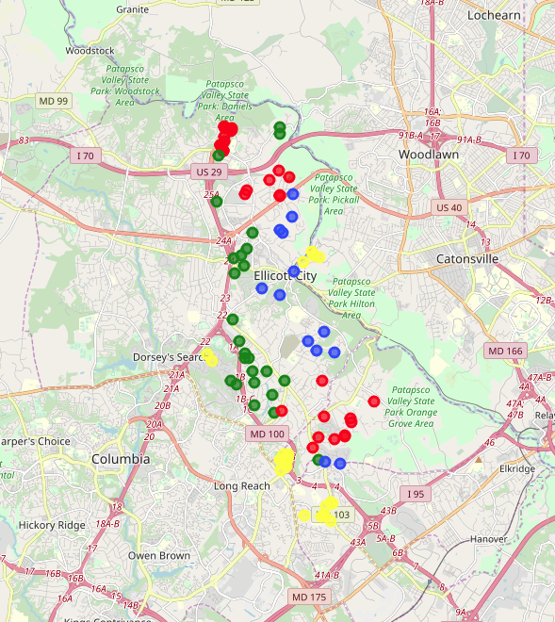
Results
K-Means Clustering Results – 4 clusters of houses
My interpretation of the 4 clusters
Clusters | Characteristics | Customers
Cluster 0 (yellow) | Relative low overall school ratings, most common venues are American Restaurant, Coffer Shop and Gym | Singles or Couple without kids
Cluster 1 (blue) | Highest overall school ratings, most common venues are Restaurants, Coffer Shop and Wine Shop | Family with kids
Cluster 2 (green) | Middle School Rating Score 7, most common venues are Restaurants, State Parks and Theaters | Family with kids with higher budget
Cluster 3 (red) | Some 7s in Elementary and Middle School Rating Score, relative smaller houses, most common venues are Restaurants, Coffee Shop and Playground | Family with kids with medium budget

Slide 12
Discussion & Conclusion
School Rating plays an important role – as desired and expected
Limitations
Feature reduction?
Cross-validation?
Extend to other stakeholders from myself
Established a framework to streamline the house hunting process
Flexible
Redfin data could be modified based on preference
Filter criteria could be varied
K-Means clustering results help find the next house!

